Slide 1
Instructions
In country teams, please discuss the following questions and prepare a five-minute presentation to the group.

Slide 2
Action Plan: [Name of Your Country]
[Please list the names and organizations of each member of your country’s delegation]
Integrating Variable Renewable Energy to the Grid
Washington, DC
March 1, 2016

Slide 3
Country Background
Size of system
Fuel composition
RE goals
Major interconnections
Other important information

Slide 4
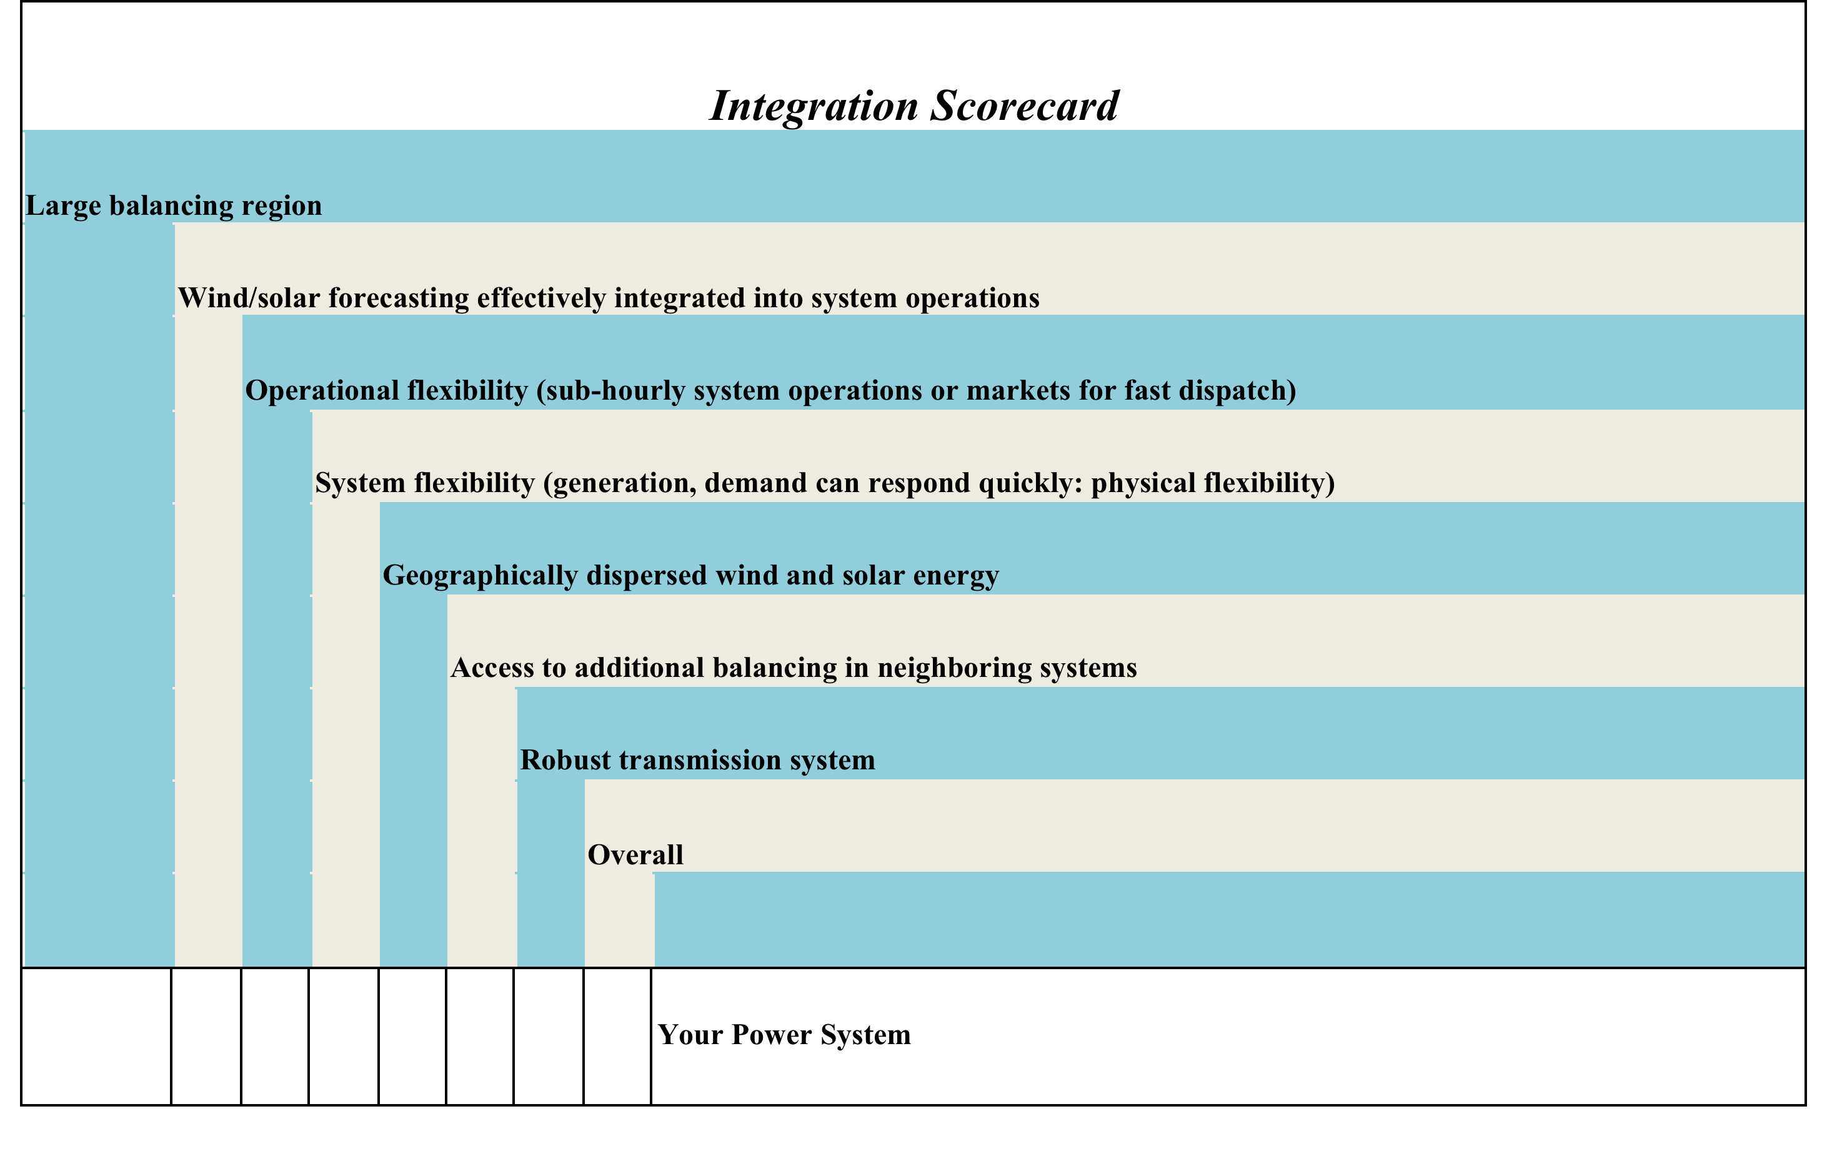
Integration Scorecard
#
#
#
#
#
#
#
#

Slide 5
List of Top 3-5 Actions (in sequential order)

Slide 6
Action 1: [Title]
Timeframe (e.g., Years 1-2, 2-3, 4-5)
Key counterparts/stakeholders:
Data and analysis gaps and needs:
Institutional and human capacity needs:
Regulatory and policy needs:
Technology needs:

Slide 7
Action 2: [Title]
Timeframe (e.g., Years 1-2, 2-3, 4-5)
Key counterparts/stakeholders:
Data and analysis gaps and needs:
Institutional and human capacity needs:
Regulatory and policy needs:
Technology needs:

Slide 8
Action 3: [Title]
Timeframe (e.g., Years 1-2, 2-3, 4-5)
Key counterparts/stakeholders:
Data and analysis gaps and needs:
Institutional and human capacity needs:
Regulatory and policy needs:
Technology needs:

